Slide 1


Python for AI
Python Crash Course!
Notes:
Hello and welcome to this Practicum AI workshop.
I’m Ian Lutticken. I’m an AI Training and Support Specialist for UFIT.
In this workshop, I am going to introduce you to the Python programming language.
[NEXT SLIDE]

Slide 2

Python
Time | Topic | Minutes
1:00 | Get logged into Atlas, Welcome | 10
1:10 | Jupyter Notebook Basics walkthrough | 20
1:30 | 5 min Break | 5
1:35 | Intro to Python | 10
1:45 | Python NB 01 Self-Paced | 25
2:10 | Python NB 01 Review | 20
2:30 | 5 min Break | 5
2:35 | Pandas and Data Wrangling | 10
2:45 | Python NB 02 Self-Paced | 25
3:10 | Python NB 02 Review | 20
3:30 | 5 min Break | 5
3:35 | Python NB 03 Self-Paced | 15
3:50 | Python NB 03 Review | 10
4:00 | Plotnine and Data Visualization | 10
4:10 | Python NB 04 Self-Paced | 25
4:35 | Python NB 04 Review | 20
4:55 | Exit Survey | 5
5:00 | End
Hold on to your keyboards!
Notes:
Here is today’s schedule. The goal is to take you from zero coding experience, through the basics of coding environments and code, and ending with some examples of data analysis and visualization. It is a lot of content in a very short amount of time.

Slide 3


Python
Notes:
If Python is the “paint” of programming, we still need a “canvas”. The place where we type code is called our Environment. Some environments have built in tools for making coding easier, and those are called Integrated Development Environments, or IDEs. There are many, *many* IDEs, but a popular tool for Python development is Jupyter Notebooks.
Jupyter Notebooks let you combine your code, explanations, and visualizations in one place. Its cell structure also makes iterating on code simpler. This makes it easier to experiment, share your work with others, and teach with!

Slide 4
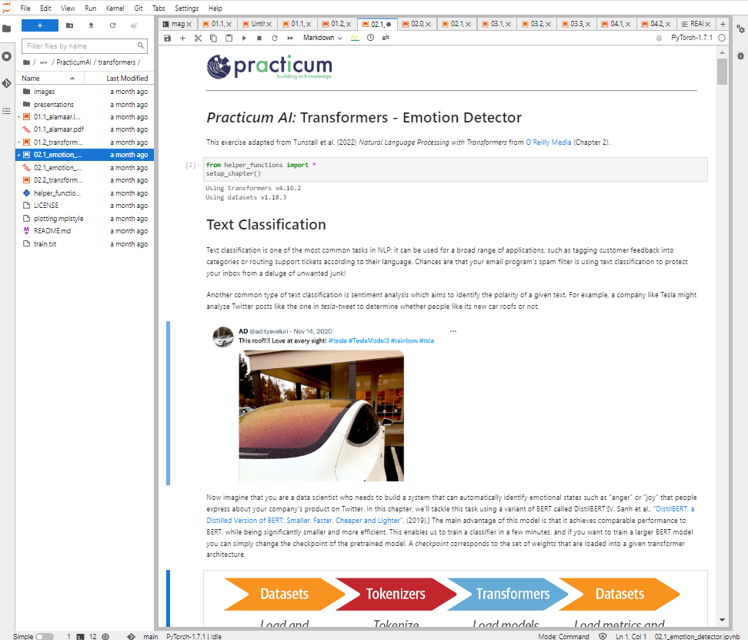
JupyterLab
Notes:
To access Jupyter Notebooks, we’ll be using JupyterLab. JupyterLab is a user interface built to facilitate navigating file systems and loading notebooks. Nothing crazy!
Let’s go ahead and get into JupyterLabs and open our first notebook.

Slide 5
Time | Topic | Minutes
1:00 | Get logged into Atlas, Welcome | 10
1:10 | Jupyter Notebook Basics walkthrough | 20
1:30 | 5 min Break | 5
1:35 | Intro to Python | 10
1:45 | Python NB 01 Self-Paced | 25
2:10 | Python NB 01 Review | 20
2:30 | 5 min Break | 5
2:35 | Pandas and Data Wrangling | 10
2:45 | Python NB 02 Self-Paced | 25
3:10 | Python NB 02 Review | 20
3:30 | 5 min Break | 5
3:35 | Python NB 03 Self-Paced | 15
3:50 | Python NB 03 Review | 10
4:00 | Plotnine and Data Visualization | 10
4:10 | Python NB 04 Self-Paced | 25
4:35 | Python NB 04 Review | 20
4:55 | Exit Survey | 5
5:00 | End
5 Minute Break!
Go look at a tree!
Notes:
See you in 5 minutes!

Slide 6
Variables
Notes:
Hello and welcome to this Practicum AI recording.
I’m Dan Maxwell. And I work as an AI Trainer for Research Computing, here at the university of Florida.
In this short briefing, I’m going to introduce you to Python operators.
[NEXT SLIDE]

Slide 7

Variables
Notes:
In computer science, a variable is a named location in memory. Consider this clear plastic container with a variety of objects in it. Each object is a specific size and takes up a certain amount of space. Now think of this container as your computer’s memory. Each time you create and assign a specific value to a variable, the Python interpreter allocates space in memory large enough to contain whatever you assign to it. Or to use a container analogy, it creates a box to hold its value. The variable’s datatype determines the amount of memory required to hold it. Large objects require larger boxes while small objects take up less space. Just as we see in the image shown here.
[NEXT SLIDE}

Slide 8


Slide 9
Python Variables
Python variables are dynamically typed
The data type is inferred by the data that is assigned
Pros
Quick
Usually correct
Cons
May get ‘interesting’ results
Slower
Variable | Type | Value
a = 123 | Int | 123
b = 3.1415 | Float | 3.1415
c = 4 | int | 4
d = c / 2 | float | 2.0
e = ‘Hello!’ | str | Hello
Notes:
Alright – let’s dive into the details of Python variables. A couple points.
Python variables are dynamically declared. So, what does that mean? Well, a dynamically declared variable is created at runtime, as the Python interpreter reads each line of your program. In other words, the variable’s name, datatype, and size is created on the fly, while your program is running.
The interpreter infers the variable’s type. Take, for example, line 9 of our code. Here we assign a string of characters to variable e. And because this string of characters is enclosed in single quotes, the interpreter infers that its type is str (string).
Pros
Quick
Usually correct
Cons
You may get unintended results
Variable manipulation is slower with interpreted languages
[NEXT SLIDE]

Slide 10
Variable Name Rules
Variable names (in Python) are case sensitive and MUST
Begin with a letter (or an underscore)
Not contain a space or a period (.)
Not be a reserved keyword
Be unique (can’t be the same as another variable or function name)
Not more than 79 Characters (if this is a problem, we need to talk!)
Notes:
Variable names (in Python) are case sensitive and MUST
Begin with a letter (or an underscore)
Not contain a space or a period (.)
Not be a reserved keyword – we’re going to see the list of Python reserved words in the next slide…
Be unique (can’t be the same as another variable or function)
Not be more than 79 Characters in length (if this is a problem, we need to talk!)
[NEXT SLIDE]

Slide 11
Reserved words
False | await | else | import | pass
None | break | except | in | raise
True | class | finally | is | return
and | continue | for | lambda | try
as | def | from | nonlocal | while
assert | del | global | not | with
async | elif | if | or | yield
Notes:
Every language has a set of reserved words. These cannot be used as variable or function names. The list of Python reserve words is shown here. Best practice is to avoid these altogether.
[NEXT SLIDE]

Slide 12
Variable Naming Recommendations
Naming conventions are suggested, not required
Make your names intuitive, readable, concise, and consistent!
Begin variable names with a lower case letter (“a” not “A”)
Use “camel casing” – capitalize each new “word” (myVar, sumDollars)
OR
Use underscores to separate each “word” (my_var, sum_dollars)
Notes:
And let’s close out this short briefing with some variable naming recommendations. If you implement these suggestions, your code will be cleaner and easier to read.
Make your names intuitive, readable, concise, and consistent!
Begin variable names with a letter in lower case (“a” not “A”)
And then use “camel case” – capitalize each new “word” (myVar, sumDollars)
OR
Use underscores to separate each “word” (my_var, sum_dollars) - this is my preference…
[NEXT SLIDE]

Slide 13
Operators
Notes:
Hello and welcome to this Practicum AI recording.
I’m Dan Maxwell. And I work as an AI Trainer for Research Computing, here at the university of Florida.
In this short briefing, I’m going to introduce you to Python operators.
[NEXT SLIDE]

Slide 14
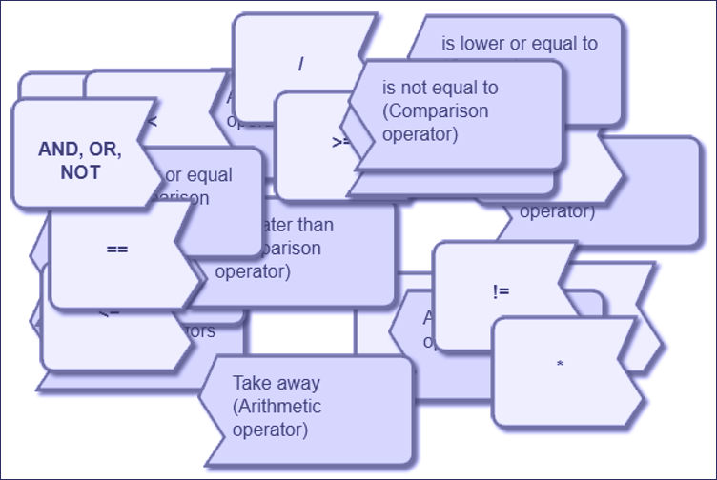
https://www.101computing.net/computing-operators/
Notes:
In computer science, an operator is a symbol or function that specifies an action to be performed on one or more operands (values or variables). What follows will be a quick tour of Python’s operators. You’ll want to spend more time on these as there is an operator for every mission, every situation.

Slide 15
Python Arithmetic Operators
Addition +
Subtraction -
Multiplication *
Division /
Exponent (power) ** (3**2)
Grouping ( )
Integer (floor) Division //
Modulus %
Remainder i.e. 5 % 2 = 1
Notes:
Python’s basic arithmetic operators are as follows:
Addition and Subtraction
Multiplication and Division
Exponent and Grouping
Integer (floor) Division
Modulus – the remainder from a division operation
[NEXT SLIDE]

Slide 16
Python Comparison Operators
Comparison Operators compare 2 numbers or strings
They always return a Boolean value (True or False)
Equal to == (note that this is different than ‘=‘) .
Less Than <
Greater Than > xxxxx xxxxxxxxxxxxxxx x xx
Less than or equal to <=
Greater than or equal to >=xx xxxxx xxxxxxxxxxxxx xxx
Not Equal to !=
(! is often called "bang" and stands for "not")
Notes:
And let’s look at the comparison operators. Two key points: a) Compare two numbers or strings, b) these always return a Boolean value (True or False).
Equal to – note the double equal signs
Less than
Greater than
Less than or equal to
Greater than or equal to
Not equal to
[NEXT SLIDE]

Slide 17
Other Operators
Logical Operators
and - evaluates to True if left and right sides are BOTH True (5 > 2) and (90 < 100)
or - evaluates to True EITHER left or right sides are True (5 < 2) or (90 < 100)
not - reverses True to False and vice versa
Identity Operators
is - returns True if both variables are the same object
is not - returns True if both variables are NOT the same object
Membership Operators
in - returns True if specified sequence is present in the object (x in y)
not in - returns True if specified sequence is NOT in the object (x not in y)
Notes:
And let’s take a quick look at some of Python’s other operators…
Logical Operators - A historical note – these are often called Boolean operators, named after George Boole, a 19th century English mathematician who formalized the field of Boolean algebra.
and - evaluates to True if left and right sides are BOTH True (5 > 2) and (90 < 100)
or - evaluates to True if EITHER left or right sides are True (5 < 2) or (90 < 100)
not - reverses True to False and vice versa
Identity Operators
is - returns true if both variables are the same object
is not - returns true if both variables are NOT the same object
Membership Operators – I really like these operators because these allow you to quickly find a string of characters is in another string. Python + Bioinformatics = TRU LOVE?
in - returns true if specified sequence is present in the object (x in y)
not in - returns true if specified sequence in NOT in the object (x not in y)
[NEXT SLIDE]

Slide 18
Python Assignment Operators
Python has several augmented operators that allow assignment and operations to be done simultaneously (but no unary increment or decrement, ++ or -- )
Operator | Example | Equivalent to
= | x = 5 | x = 5
+= | x += 5 | x = x + 5
-= | x -= 5 | x = x - 5
*= | x *= 5 | x = x * 5
/= | x /= 5 | x = x / 5
%= | x %= 5 | x = x % 5
//= | x //= 5 | x = x // 5
**= | x **= 5 | x = x ** 5
Notes:
In a previous slide, I mentioned the assignment operator. Let’s now take a quick look at the full range of assignment operators available in Python. Note: Python supports augmented assignment operators as well. These are kind of neat because you get both an assignment and an operation at the same time. I like the augmented assignment operators because they allow you to be concise and save typing time.
[NEXT SLIDE]

Slide 19
DataTypes
Notes:
Hello and welcome to this Practicum AI recording.
I’m Dan Maxwell. And I work as an AI Trainer for Research Computing, here at the university of Florida.
In this short briefing, I’m going to introduce you to Python datatypes.
[NEXT SLIDE]

Slide 20
Data Types
Notes:
To get us started, let’s revisit a slide from our Variables presentation. In that briefing, I presented this image of a plastic container, divided into boxes which hold a variety of differently sized objects. You can think of a variable’s datatype or type as simply the kind of object in each box. The datatype determines the amount of memory that must be allocated to hold a variable – the size of the box – and it limits the kinds of things you can do with it. For example, you cannot divide a string variable by another string. That makes no sense.

Slide 21
Flow chart showing Python data types
Int
20
Numbers
Float
35.75
Bool
complex
True, False
1+3j
Python Data
Types
Set
{2, 4, 6}
Dict
String
{1:’a, 2:’b’}
‘Jessa’
List
Sequence
[2, ’a’, 5.7]
Tuple
(3, 4.5, ‘b’)
Image Credit: https://pynative.com/python-data-types/
Notes:
Here are the base Python data types.
And the most common datatypes are:
Integer (int)
Float (float) - double-precision only, with decimal point
String (str) – delimited by single OR double quotes
Boolean (bool) – True / False
Please take some time to explore the other types. These are not as prevalent in ML applications. Even so, you should know what they are and what you can do with them.
[NEXT SLIDE]

Slide 22
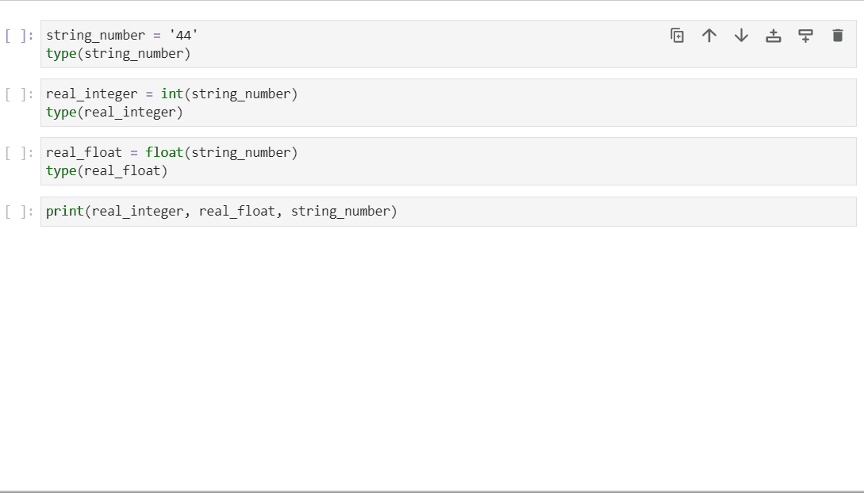

Functions for typecasting variables
This Photo by Unknown Author is licensed under CC BY-NC
Notes:
Sometimes, you may need to convert a variable to another datatype. In computer science, this is called typecasting. In this simulation, we first assign a string (‘44’) to the string_number variable and then verify its type. We then typecast this string using the int() function and assign it to real_integer. And then, we typecast this variable using the float() function and assign it to real_float. And finally, we print all three variables.
But do you notice something interesting here? The string_number and real_integer variables look identical when printed. That can be confusing, especially when you try to do some arithmetic on that string variable. If you do, Python pops an ugly warning message. So, here we see a practical need for typecasting. I’ve encountered this same situation multiple times in my programming career!
[NEXT SLIDE]

Slide 23
Functions for typecasting variables
int() | string, floating point to Integer
float() | string, integer to floating point number
str() | integer, float, list, tuple, dictionary to string
list() | string, tuple, dictionary to list
tuple() | string, list to tuple
This Photo by Unknown Author is licensed under CC BY-NC
Notes:
… and for future reference, here’s a list of Python’s most used typecasting functions.
[NEXT SLIDE]

Slide 24
Coding Style and Documentation
Notes:
Hello and welcome to this Practicum AI recording.
I’m Dan Maxwell. And I work as an AI Trainer for Research Computing, here at the university of Florida.
In this short briefing, I’m going to introduce you to coding style and documentation.
[NEXT SLIDE]

Slide 25
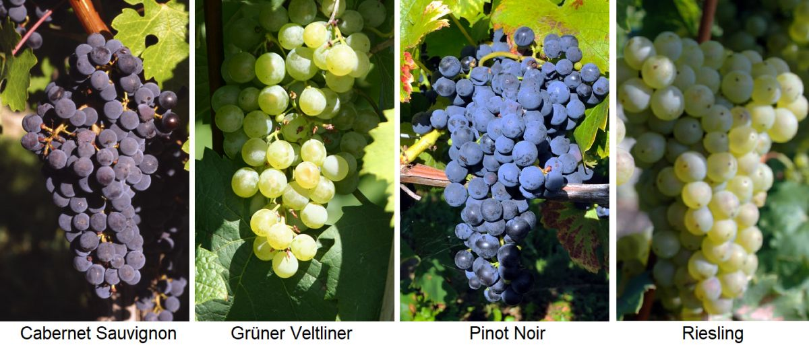
Classification is Important
Image: https://glossary.wein.plus/quality-wine-grape-varieties
Notes:
The imperative to properly name and classify things has existed for a long time. In agriculture, this is especially important as each variety of living organism comes with its own unique set of properties.
Donald Knuth, one of the greatest computer scientists alive today, developed the idea of literate programming in the early 1980’s. He argued that a programmer writes code not just for the computer but for other humans as well. Thus, the names we give things and the documentation we write is critically important.
[NEXT SLIDE]

Slide 26
Python Comments
Inline comments
Precede with #
Use comments liberally!
Comments are for the future you!
They are also good for debugging, by activating or deactivating parts of your code
Notes:
And let’s conclude this short briefing with a quick review of Python Comments…
Inline comments
Precede with #
Use comments liberally!
Comments are for the future you – for when you come back to a piece of code at some point in the future.
They are also good for debugging, by activating or deactivating parts of your code
[NEXT SLIDE]

Slide 27
Functions
Notes:
Hello and welcome to this Practicum AI recording.
I’m Dan Maxwell. And I work as an AI Trainer for Research Computing, here at the university of Florida.
In this short briefing, I’m going to introduce you to coding style and documentation.
[NEXT SLIDE]

Slide 28
Functions quote
“You can think of a function as a small program inside a program. The basic idea of a function is that we write a sequence of statements and give that sequence a name. The instructions can then be executed at any point in the program by referring to the function name…
When a function is subsequently used in a program, we say that the definition is called or invoked.”
John Zelle
Notes:
So, what exactly is a function? I like this quote by computer science educator John Zelle. Zelle is the author of the bestselling textbook, Python Programming: An Introduction to Computer Science. Zelle writes, “The basic idea of a function is that we write a sequence of statements and give that sequence a name. The instructions can then be executed at any point in another program by referring to the function’s name.”
Zelle, J. (2017). Python Programming: An Introduction to Computer Science (3rd edition). Franklin, Beedle, & Associates. Portland, OR.
[NEXT SLIDE]

Slide 29
Why use Functions?
Main Program
function
load_data()
function data_prep()
function
train()
function
clean_mising()
function normalize()
function
model()
Notes:
So why are functions a good idea? Why do we use them? When designed properly, a function performs a single, specific task. This, in turn, allows us to design modular programs. Imagine a box of Lego bricks that snap together. In computer science, the bricks (or functions) are said to be reusable. And because they are reusable, we can build just about anything with them.
[NEXT SLIDE]

Slide 30
A function is a self-contained block of code…
It may accept inputs (parameters)
It will output (return) one or more results. Sometimes, the returned value is nothing! (None)
Can contain any statements found in a normal program
We've already encountered functions: i.e., int(), float(), range(), and many more – these are "built-in functions". The functions we write ourselves are "user-defined" functions
Source: Randy Switt – University of Florida (Pythonista)
Notes:
Let’s unpack that definition just a bit...
[NEXT SLIDE]

Slide 31
Advantages of Functions
Code Reuse
Simplicity
Flexibility
Ease of Testing
Improved Collaboration
Notes:
Reusable functions offer many advantages:
Code reuse: Reusable functions can be used repeatedly in different parts of a program or in different programs altogether. This leads to less code duplication and ease of maintenance.
Simplicity: Reusable functions designed to perform a specific task are easier to understand and work with. Developers can focus on the individual parts of a program, rather than the entire codebase.
Flexibility: Reusable functions can be modified and adapted to suit different scenarios and requirements. In other words, the same function can be used in different contexts, reducing the need for new code.
Ease of testing: Reusable functions are easier to test since they can be tested independently of the rest of the program. This helps us quickly identify and fix bugs. The result is reliable, stable software.
Improved collaboration: When functions are modular and reusable, multiple developers can work on different parts of a program simultaneously. The result is efficient collaboration and faster development.
[NEXT SLIDE]

Slide 32
Don’t repeat yourself
Thou shalt not repeat thyself
Thou shalt not repeat thyself
Thou shalt not repeat thyself
Thou shalt not repeat thyself
Notes:
One of the cardinal rules of good programming is stated here: Thou shalt not Repeat Thyself. In other words, "Every piece of knowledge or logic must have a single, unambiguous representation within a system." All that to say, if you want to do the same thing multiple times in your code, write a function, and call it wherever it is needed.
[NEXT SLIDE]

Slide 33
Syntax for Creating a Function
def <name>():
<statements>
return <values>
def hello():
print(‘Hello!')
Source: Randy Switt – University of Florida (Pythonista)
Notes:
Alright, let’s look at how you create a Python function…
This is the syntax as you might see it in support documentation.
def – keyword indicating a function
<name> - name of the function. The same rules we learned about for naming variables also apply here.
return – optional statement to return value(s) to the calling program
And here’s a small block of code to create a function called “Hello”
[NEXT SLIDE]

Slide 34
Syntax for Calling a Function
<function_name>()
def hello():
print('Hello!')
hello()
Hello!
Source: Randy Switt – University of Florida (Pythonista)
Notes:
And now, we call our newly created function, and it prints “Hello!” to the output. A couple key points:
A function can only be called after it is defined. Thus, order matters in Python.
A function can be (and usually is!) called many times. That’s the power of reusability!
[NEXT SLIDE]

Slide 35
Function Parameters and Arguments
def <function_name>(param1, param2, . . .)
Source: Randy Switt – University of Florida (Pythonista)
Notes:
At this point, I need to clarify some vocabulary. Parameters and Arguments.
Function parameters are input variables defined ("declared") in the function definition. A function can have 0 to many parameters.
But when you call a function, you must provide arguments for each required parameter.
[NEXT SLIDE]

Slide 36
Parameters vs Arguments
Parameter
def hello(name):
print(f'Hello {name}!')
myName = input('Name? ')
hello(myName)
Argument
Source: Randy Switt – University of Florida (Pythonista)
Notes:
Although I provide a technical definition here, these two terms are often used interchangeably in real life.
Parameter = "Placeholder"
Defined by the function
the "place" where values are assigned when the function is called
Argument = "Actual values"
specified when calling the function
specifies actual values or variables that will be used as inputs
[NEXT SLIDE]

Slide 37
Returning Values
return <value1>,<value2>, . . .
def hello(name):
print(f'Hello {name}!’)
return True
myName = input('Name? ')
status = hello(myName)
print(status)
Name? Randy
Hello Randy!
True
Source: Randy Switt – University of Florida (Pythonista)
Notes:
Now in an earlier slide, I mentioned that functions can – and usually do – return values. To specify return values, we use the reserved word "return" followed by one or more values or variables. Let’s run this block of code and see what we get… First, the program asks for our name and assigns that value to the myName variable. It then passes the myName variable to the hello() function. The hello() function, in turn, prints “Hello <name>” and returns True. And finally, the return value is assigned to the status variable and printed. Note: It is good form to have a function return a status and assign that to a variable, as we do here.
[NEXT SLIDE]

Slide 38
Call by Position or Keyword
def hello(name):
print(f'Hello {name}!')
myName = input('Name? ')
# Call by position
hello(myName)
# Call by keyword
hello(name = myName)
Notes:
When calling a function and passing arguments to it, you can do so in two ways – by position or by keyword. My personal preference is to pass arguments by KEYWORD. When passing by keyword, you explicitly specify the parameters receiving each of your arguments. Here we see that the name parameter will receive the myName argument. The beautiful thing about this approach is that you know exactly what's being passed to what. And your code becomes self-documenting. This is important when you come back to a piece of code after a long time. Write code for the future you!
[NEXT SLIDE]

Slide 39
Time | Topic | Minutes
1:00 | Get logged into Atlas, Welcome | 10
1:10 | Jupyter Notebook Basics walkthrough | 20
1:30 | 5 min Break | 5
1:35 | Intro to Python | 10
1:45 | Python NB 01 Self-Paced | 25
2:10 | Python NB 01 Review | 20
2:30 | 5 min Break | 5
2:35 | Pandas and Data Wrangling | 10
2:45 | Python NB 02 Self-Paced | 25
3:10 | Python NB 02 Review | 20
3:30 | 5 min Break | 5
3:35 | Python NB 03 Self-Paced | 15
3:50 | Python NB 03 Review | 10
4:00 | Plotnine and Data Visualization | 10
4:10 | Python NB 04 Self-Paced | 25
4:35 | Python NB 04 Review | 20
4:55 | Exit Survey | 5
5:00 | End
5 Minute Break!
Stay Hydrated!
Notes:
See you in 5 minutes!

Slide 40
Data Wrangling
Notes:
Hello and welcome to this Practicum AI recording.
I’m Dan Maxwell. And I work as an AI Trainer for Research Computing, here at the university of Florida.
In this short briefing, I’m going to introduce you to coding style and documentation.
[NEXT SLIDE]

Slide 41
What is Data Wrangling?
Data Wrangling is the process of gathering, collecting, and transforming raw data into another format for better understanding, decision-making, accessing, and analysis in less time.
Discovery
Structuring
Cleaning
Publishing
Validating
Enriching
Steps in data wrangling
Sources: A Handy Guide to Data Wrangling and Importing CSV in Python (turing.com)
Notes:
There are 6 broad steps in data wrangling, which are:
Step 1 Discovery: Understanding the data.
Step 2 Structuring: Structuring different data types into standardized formats.
Step 3 Cleaning: Eliminating redundant and incomplete data.
Step 4 Enriching: Enhancing data by supplementing it with data from internal/external sources.
Step 5 Validating: Checking for accuracy and data quality.
Step 6 Publishing: Releasing data for analytics.
=====
https://www.turing.com/kb/data-wrangling-and-importing-csv-in-python

Slide 42
Importance of Data Wrangling
20%
80%
Data Exploration and Modeling
Data Wrangling
Notes:
Did you know, data professionals spend almost 80% of their time wrangling the data, leaving a mere 20% for exploration and modeling?
Some may question if the amount of work and time devoted to data wrangling is worth the effort.
A simple analogy will help you understand. The foundation of a skyscraper is expensive and time-consuming before the above-ground structure starts. Still, this solid foundation is extremely valuable for the building to stand tall and serve its purpose for decades. Similarly, once the code and infrastructure foundation are gathered for data handling, it will deliver immediate results (sometimes almost instantly) for as long as the process is relevant.
However, skipping necessary data-wrangling steps will lead to significant downfalls, missed opportunities, and erroneous models that damage the reputation of analysis within the organization.
====
https://www.simplilearn.com/data-wrangling-article
https://www.datanami.com/2020/07/06/data-prep-still-dominates-data-scientists-time-survey-finds/

Slide 43





Data
Duplicates
Missing
Outliers
Data
data
formatting
errors
Common Data Wrangling Challenges
Sources: Taming the Data Beast: The Art of Efficient Data Wrangling (capellasolutions.com)
Notes:
Here are some common challenges that data wranglers face:
Data quality issues: Data may be incomplete, inconsistent, or inaccurate, which can lead to errors in analysis.
Data format issues: Data may be in different formats, such as CSV, JSON, or XML, and may require conversion to a unified format for analysis.
Data size issues: As data volumes continue to grow, processing and analyzing large datasets can become a significant challenge.
Data integration issues: Combining data from different sources can be difficult, especially if the data has different structures or uses different identifiers.
====
https://www.capellasolutions.com/blog/taming-the-data-beast-the-art-of-efficient-data-wrangling

Slide 44
Data Wrangling Techniques
Cleaning
Removing or correcting data that is incorrect, incomplete, or irrelevant.
Parsing
Breaking down complex data structures into simpler, more manageable forms.
Aggregating
Joining
Filtering
Selecting a subset of the data based on specific criteria, such as data ranges or numerical values.
Combining data from multiple sources into a single, unified dataset.
Summarizing data into groups or categories, such as calculating averages or counts.
Sources: Taming the Data Beast: The Art of Efficient Data Wrangling (capellasolutions.com)
Notes:
To overcome challenges, data wranglers need to use a combination of tools, techniques, and best practices.
Data-wrangling techniques are diverse, encompassing processes such as Data Cleaning, Data Parsing, Data Filtering, Data joining, and Data Aggregating. It is important to note that this list is not exhaustive, as there are many other data-wrangling techniques available.

Slide 45

Data Wrangling Best Practices
Test your work
Document your work
Keep the original data
Plan ahead
Automate where possible
Sources: Taming the Data Beast: The Art of Efficient Data Wrangling (capellasolutions.com)
Notes:
To ensure a successful and efficient data-wrangling process, here are some practices you can implement.
Plan: Define the objectives of your data-wrangling project and plan out the necessary steps and tools to achieve your goals.
Documentation: Keep track of the data-wrangling process and document any changes made to the data, enabling others to understand your work and reproduce your results.
Test: Test your data-wrangling processes on a small subset of the data before applying them to the full dataset to ensure they're functioning as intended.
Preservation: Always keep a copy of the original data in case you need to revisit and make changes or corrections later.
Automate: Use tools and techniques to automate repetitive or complex data-wrangling tasks, such as writing scripts or macros.

Slide 46


Pandas
Notes:
Hello and welcome to this Practicum AI recording.
I’m Dan Maxwell. And I work as an AI Trainer for Research Computing, here at the university of Florida.
In this short briefing, I’m going to introduce you to basic data statistics and visualization.
[NEXT SLIDE]

Slide 47

pandas
Notes:
So, what is Pandas? I thought the Panda was a cute bear from China. Well – in this case – Pandas is a data wrangling framework. The creators of this tool describe it this way:
Pandas is a fast, powerful, flexible and friendly open-source API (application programming interface), built on top of the Python programming language.
In short, Pandas provides a wonderful set of tools for managing 2-dimensional data. What? Well, that’s nothing more than data in a table.

Slide 48
Anatomy of the Pandas DataFrame
Column 3
Column 4
Column Header
Rows
Series 1
Series 2 …
Notes:
At the very heart of Pandas lies the dataframe. And in my opinion, the Pandas DataFrame is one of the greatest inventions since sliced bread. The DataFrame is a powerful and useful data structure – a natural fit for table data – data usually stored in a plain text file, separated by tabs.
A DataFrame is a named 2-dimensional object…
… Comprised of rows and columns.
The first row in a dataframe contains the column headings.
You can also think of the dataframe as a collection of one-dimensional series.
So, the DataFrame is the way Pandas represents a table, and a Series is the data-structure Pandas uses to represent a column. Note: Pandas is built on top of the Numpy library. Thus, most of the functions used to manage Numpy Arrays also work with Pandas Series and DataFrames.

Slide 49
Creating a DataFrame from a File
Continent | Country | gdpPerCap_2002 | gdpPerCap_2007
Americas | Argentina | 8797 | 12779
Asia | South Korea | 19233 | 23348
Asia | Japan | 28604 | 31656
Notes:
Dataframes can be created in a variety of ways. You can create a dataframe manually or you can do it automagically through a file upload.
Here’s the simple line of code to load a comma separated file (a .csv file) into a dataframe.
Behind the scenes, the method loads the .csv file and then inserts the contents into the dataframe data structure, as we see here.
In addition to the read_csv() method, Pandas also supports data uploads from a variety of other sources such as Excel, pickle files, URLs and more.

Slide 50
Adding a New Column
Continent | Country | gdpPerCap_2002 | gdpPerCap_2007
Americas | Argentina | 8797 | 12779
Asia | South Korea | 19233 | 23348
Asia | Japan | 28604 | 31656
gdpChange
3982
4115
3052
Notes:
Sometimes, you may want to add a column to an existing dataframe. And the code to do that is shown here. Note carefully how the column names are referenced in this sample code, as strings in single quotes, inside brackets.
And here’s what happens when you execute this line of code to calculate the difference between two columns.”

Slide 51
Dropping a Column
Continent | Country | gdpPerCap_2002 | gdpPerCap_2007
Americas | Argentina | 8797 | 12779
Asia | South Korea | 19233 | 23348
Asia | Japan | 28604 | 31656
gdpChange
3982
4115
3052
Notes:
...and here’s the command to drop a column or row. The axis argument specifies whether to delete a row (0) or a column (1). Here we are deleting a column.
Note: if you do not assign the dataframe back to itself – as we do here – or assign it to another variable name, the drop method does not change the original dataframe!! You can also force the change by assigning True to the inplace argument.
And here’s what happens when this line of code is executed.

Slide 52
Time | Topic | Minutes
1:00 | Get logged into Atlas, Welcome | 10
1:10 | Jupyter Notebook Basics walkthrough | 20
1:30 | 5 min Break | 5
1:35 | Intro to Python | 10
1:45 | Python NB 01 Self-Paced | 25
2:10 | Python NB 01 Review | 20
2:30 | 5 min Break | 5
2:35 | Pandas and Data Wrangling | 10
2:45 | Python NB 02 Self-Paced | 25
3:10 | Python NB 02 Review | 20
3:30 | 5 min Break | 5
3:35 | Python NB 03 Self-Paced | 15
3:50 | Python NB 03 Review | 10
4:00 | Plotnine and Data Visualization | 10
4:10 | Python NB 04 Self-Paced | 25
4:35 | Python NB 04 Review | 20
4:55 | Exit Survey | 5
5:00 | End
5 Minute Break!
Get up and stretch!
Notes:
See you in 5 minutes!

Slide 53
Basic Data Stats & Visualization
Notes:
Hello and welcome to this Practicum AI recording.
I’m Dan Maxwell. And I work as an AI Trainer for Research Computing, here at the university of Florida.
In this short briefing, I’m going to introduce you to basic data statistics and visualization.
[NEXT SLIDE]

Slide 54
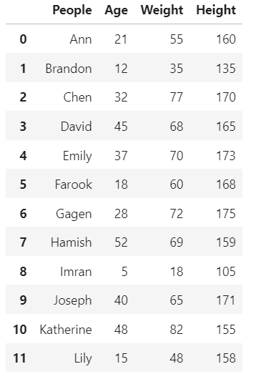
Basic Dataframe Statistics
Notes:
With any data science or AI project, the first order of business is to work up your data. What does the dataset look like? Are you missing any values? Are there outliers? Here’s the simple dataframe you’ll encounter in one of our Python notebook exercises. Let’s use it to take a quick look at some of the statistical methods built into the dataframe object.
The count() method counts the number of instances in a column.
Here we ask for the mean() or average for the Height column. You can apply this to any numeric column.
And finally, the describe() method. This method prints a list of basic statistics for each of the columns – count, mean, standard deviation, min, the 25th, 50th, and 75th percentiles, and the max value. This is a handy method as it allows you to quickly size up your dataset.

Slide 55
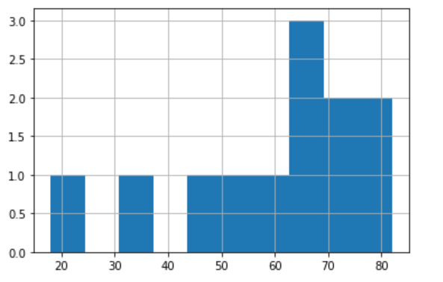
Histogram
Notes:
In addition to basic statistics, I strongly recommend that visualize your data. As they say, a picture is worth a thousand words. In the next couple of slides, I’m going to quickly introduce some basic plots. The first is the histogram.
Here’s a sample line of code to create a histogram.
And here’s what you get when you execute that line of code.
A histogram is a display of statistical information that uses bars to show the frequency of data items in successive numerical buckets of equal size.

Slide 56
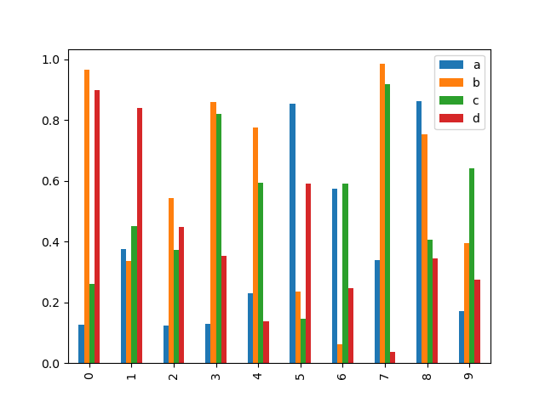
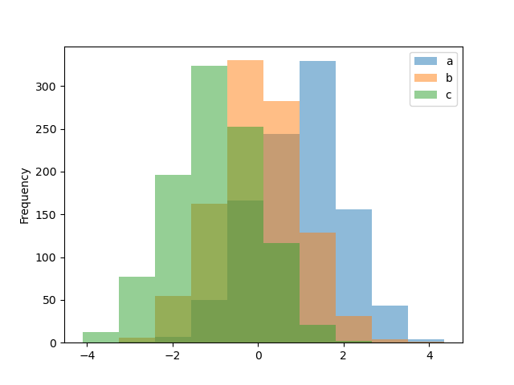
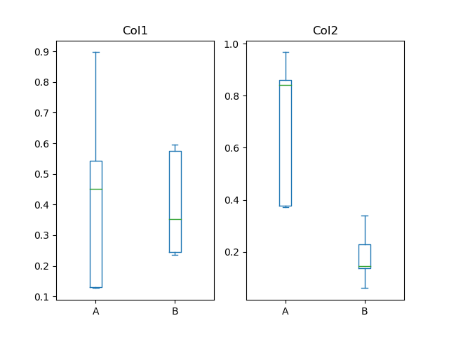
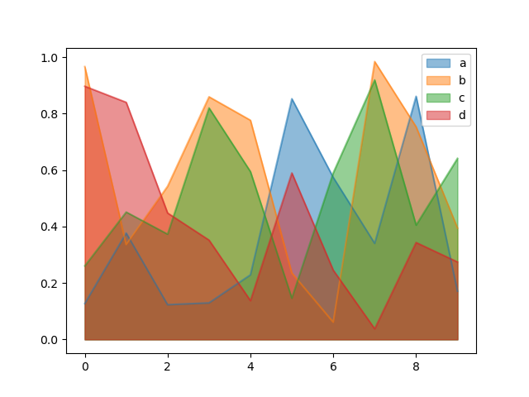
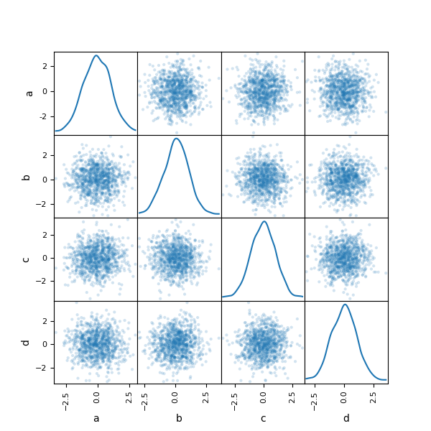
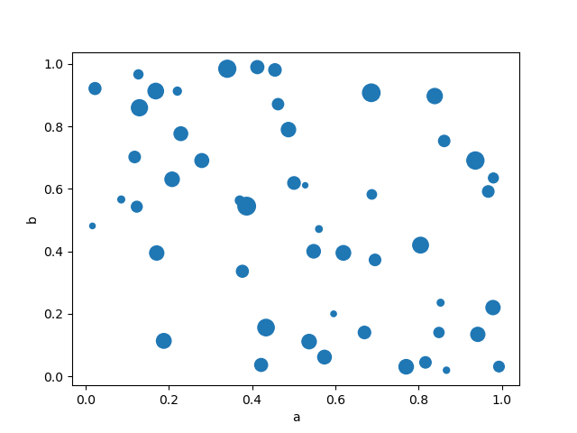
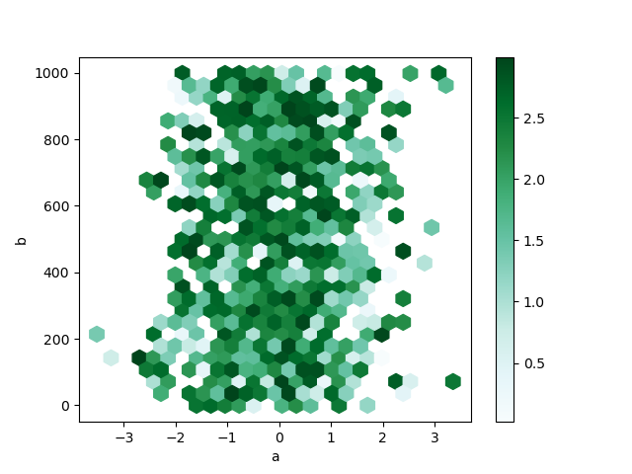
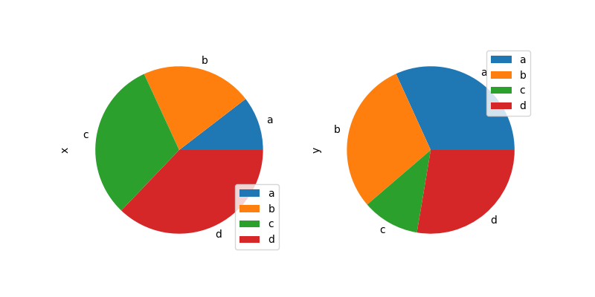
Pandas Chart Types
bar
hist
box
area
scatter
hexbin
pie
scatter_matrix

Slide 57
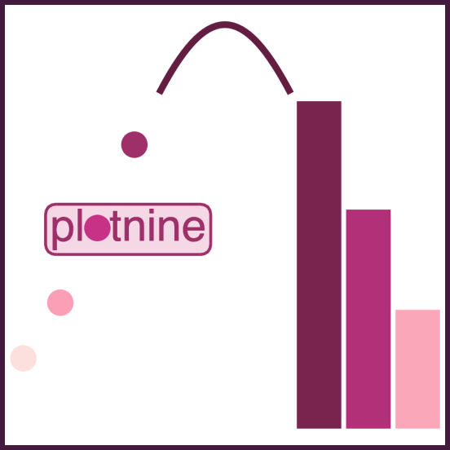
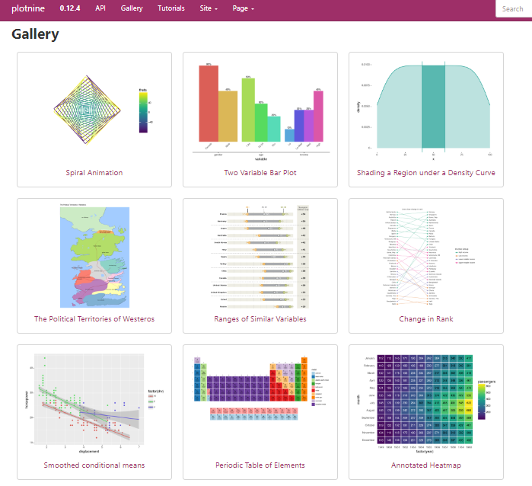

Slide 58
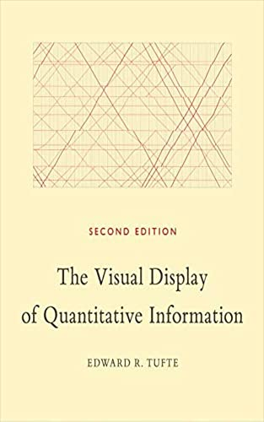

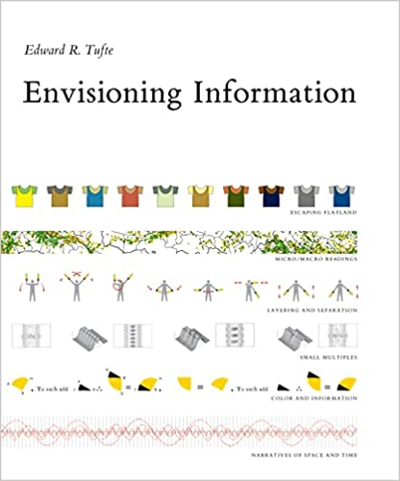
Notes:
And I end this briefing with some reading recommendations. Edward Tufte is one of the world’s leading authorities on data visualization.

Slide 59

You Made It!!!
Please help us improve our courses by taking this short survey:
https://ufl.qualtrics.com/jfe/form/SV_78QzYsgDWoC7ksS

